Slide 1
W05 – W08 Spark machine learning
2024
The Hoang

Slide 2
Learning Objectives
Understanding following:
What is Spark MLlib?
Key Features of Spark MLlib
ML Pipelines
Common ML Algorithms in MLlib
Data Types in Spark ML
Transformer and Estimator
Feature Engineering
Model Evaluation
Example: Building a Machine Learning Pipeline
Tips for Working with Spark MLlib

Slide 3

What is Spark MLlib?
Definition
Spark MLlib is the machine learning module of Apache Spark which provides several algorithms for classification, regression, clustering, collaborative filtering, dimensionality reduction, and more. It is optimized for distributed computing, allowing you to scale machine learning tasks across clusters of machines.
Spark MLlib is divided into two APIs:
RDD-based API (MLlib): The original API that works with RDDs and now is in maintenance mode.
DataFrame-based API (Spark ML): A newer API introduced in Spark 2.0, which is more user-friendly and supports DataFrames. This is primary API.
The DataFrame-based API is the recommended approach for most tasks.

Slide 4
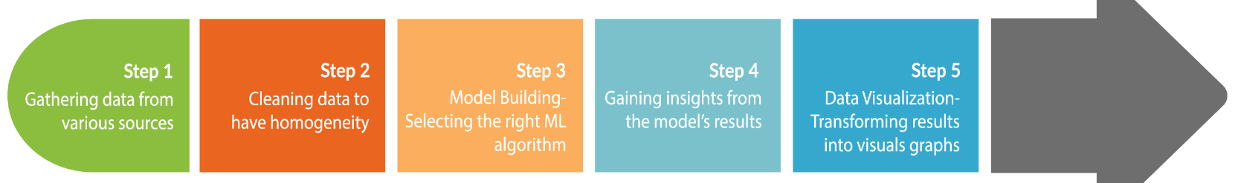
Key Features of Spark MLlib?
Scalability: MLlib is designed to work with Big Data and can easily scale to clusters of machines.
Distributed Computing: Spark MLlib uses Spark's distributed architecture, so it can distribute computations across multiple nodes.
High-Level API: The DataFrame-based API lets you use familiar SQL-like operations for machine learning tasks.
Support for Multiple Languages: You can use Spark MLlib with Scala, Java, Python (PySpark), and R.
Integration with Pipelines: Spark MLlib allows you to build complex machine learning workflows using pipelines.

Slide 5
What is a Machine Learning Workflow?
A machine learning workflow is a structured process that guides the development and deployment of machine learning models. It typically consists of several key stages:
Problem Definition: Clearly define the problem you want to solve and the objectives of your machine learning project.
Data Collection: Gather relevant data from various sources. This data can be structured (like databases) or unstructured (like text or images).
Data Preprocessing: Clean and prepare the data for analysis. This includes handling missing values, normalizing data, and encoding categorical variables.
Exploratory Data Analysis (EDA): Analyze the data to understand its characteristics, identify patterns, and visualize relationships between variables.
Feature Engineering: Create new features or modify existing ones to improve model performance. This can involve selecting the most relevant features or transforming features into a more useful format.

Slide 6
What is a Machine Learning Workflow?
Model Selection: Choose appropriate machine learning algorithms based on the problem type (e.g., classification, regression) and the nature of the data.
Model Training: Train the selected models using the prepared dataset. This involves feeding the data into the model and allowing it to learn from the data.
Model Evaluation: Assess the model's performance using metrics such as accuracy, precision, recall, and F1 score. This step often involves using a separate validation dataset.
Hyperparameter Tuning: Optimize the model's hyperparameters to improve performance. This can be done using techniques like grid search or random search.
Deployment: Implement the model in a production environment where it can make predictions on new data.
Monitoring and Maintenance: Continuously monitor the model's performance and update it as necessary to ensure it remains accurate over time.

Slide 7
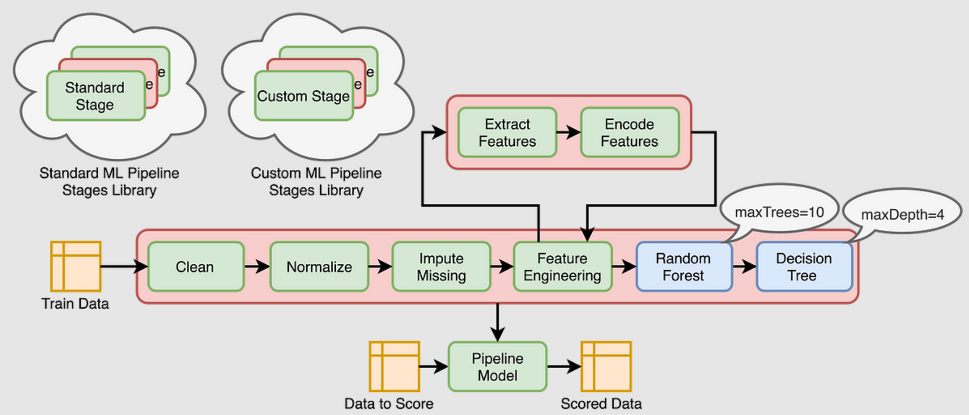
ML Pipelines

Slide 8
Spark ML Pipelines
A Pipeline in Spark MLlib is a sequence of stages where each stage is either a Transformer or an Estimator.
Pipelines help automate and streamline machine learning workflows by chaining together multiple steps, such as data processing, feature engineering, and model training.
Pipeline Components:
DataFrame: The input data for the pipeline, typically structured as rows and columns.
Transformer: A processing step that transforms the input DataFrame into another DataFrame (e.g., scaling or encoding features).
Estimator: A learning algorithm that fits a model to the data and produces a Transformer (e.g., a classifier or regressor).
Pipeline: Combines Transformers and Estimators into a sequence to be applied to the data.
Parameter: a common API to specify parameters fo all Transformers and Estimators.

Slide 9
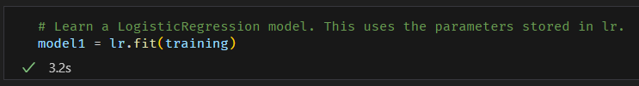
Spark ML Pipelines - Estimator
Estimator:
An Estimator implements a fit() method that takes a DataFrame and produces a Transformer (usually a fitted model).
Examples:
LogisticRegression: Fits a logistic regression model to the input data.
DecisionTreeClassifier: Fits a decision tree model to the input data.

Slide 10
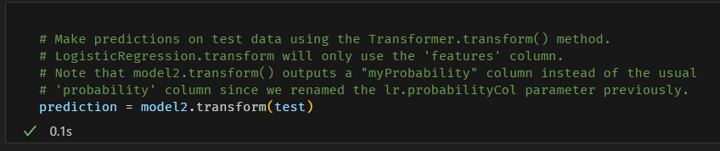
Spark ML Pipelines - Transformer
Transformer:
A Transformer is an abstraction that implements a transform() method, which converts one DataFrame into another.
Examples:
StandardScaler: Scales features to have zero mean and unit variance.
VectorAssembler: Combines multiple columns into a single vector column.

Slide 11
Spark ML Pipelines – Feature engineering
Feature engineering involves transforming raw data into features that can be used by machine learning algorithms. Spark MLlib provides various tools for feature engineering:
VectorAssembler: Combines multiple columns into a single vector column.
StringIndexer: Converts categorical string labels into numerical indices.
OneHotEncoder: Converts indexed categorical features into a one-hot encoded vector.
StandardScaler: Scales features to have zero mean and unit variance.
MinMaxScaler: Scales features to a specified range, usually [0, 1].
PCA: Reduces the dimensionality of the input data.

Slide 12
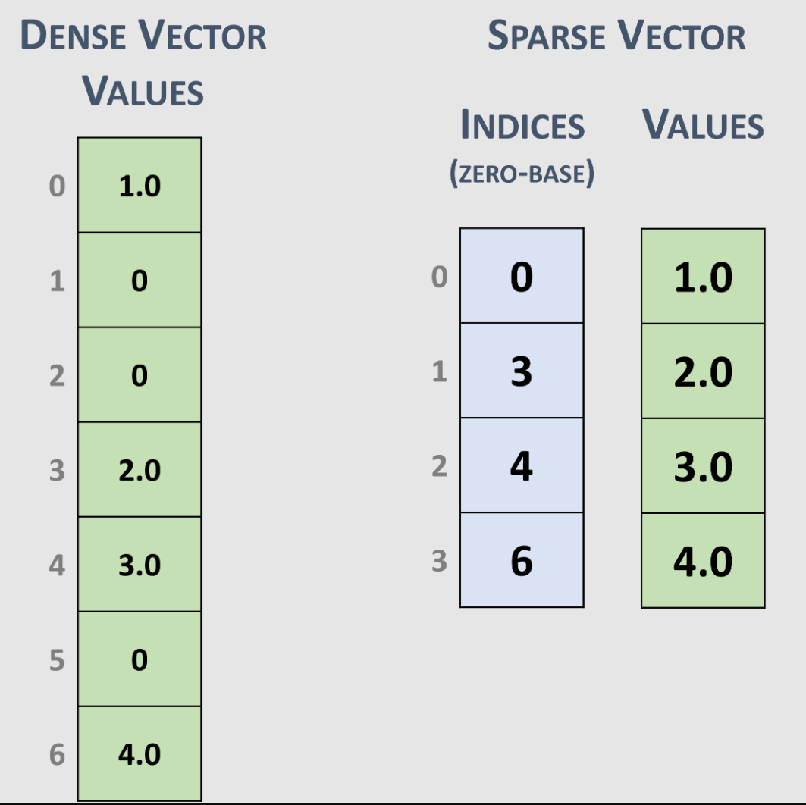
Data Types in Spark ML
2. Vectors:
MLlib uses vectors to represent features for machine learning algorithms. There are two types of vectors:
Dense Vectors: Store all entries explicitly.
Sparse Vectors: Store only non-zero elements, useful for high-dimensional data.
Structure of Sparse Vectors
A Sparse Vector is represented using two parallel arrays:
Indices: An array that contains the indices of the non-zero elements.
Values: An array that contains the corresponding non-zero values.
Examples
Dense vector: [1.0, 0.0, 3.0]
Sparse vector: (3, [0, 2], [1.0, 3.0]) represents a vector of length 3 with values 1.0 at index 0 and 3.0 at index 2.

Slide 13
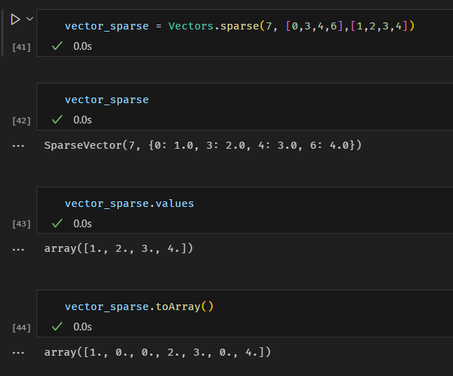
Data Types in Spark ML

Slide 14
lab practices
w06/LAB01
w06/LAB02
w06/LAB03

Slide 15
ML Algorithms
Machine Learning algorithms can generally be grouped into several broad categories based on their learning paradigms, problem types, and tasks they are designed to solve. The most common types of machine learning algorithms include:
Supervised Learning
Classification
Regression
Unsupervised Learning
Clustering
Dimensionality Reduction
Semi-Supervised Learning (not as commonly used in Spark MLlib)
Reinforcement Learning (not directly supported by Spark MLlib)
Recommendation Systems
Ensemble Methods (can be part of supervised learning)

Slide 16
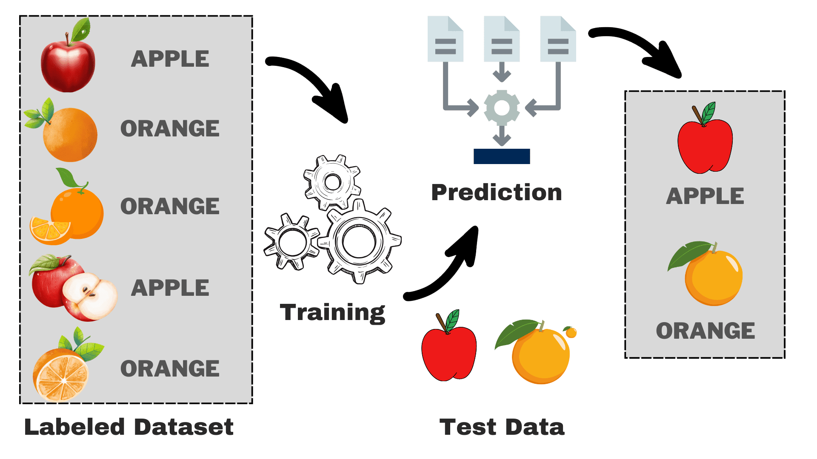
Apache Spark's Mllib – supervised learning
Supervised learning involves training a model on labeled data. For each input, the corresponding output is known, and the model learns to predict the output for unseen data.

Slide 17
Apache Spark's Mllib – supervised learning
Classification Algorithms - algorithms are used when the output is a discrete label (e.g., spam vs. not spam, fraud vs. not fraud).
Logistic Regression: org.apache.spark.ml.classification.LogisticRegression
Decision Trees (Classification): org.apache.spark.ml.classification.DecisionTreeClassifier
Random Forest (Classification): org.apache.spark.ml.classification.RandomForestClassifier
Gradient-Boosted Trees (Classification): org.apache.spark.ml.classification.GBTClassifier
Support Vector Machines (SVM): org.apache.spark.ml.classification.LinearSVC
Naive Bayes: org.apache.spark.ml.classification.NaiveBayes
Multilayer Perceptron (Neural Networks): org.apache.spark.ml.classification.MultilayerPerceptronClassifier
Use Cases:
Email Spam Detection
Fraud Detection
Image Classification

Slide 18
Apache Spark's Mllib – supervised learning
Regression Algorithms - algorithms are used when the output is a continuous value (e.g., predicting house prices, stock prices).
Linear Regression: org.apache.spark.ml.regression.LinearRegression
Decision Trees (Regression): org.apache.spark.ml.regression.DecisionTreeRegressor
Random Forest (Regression): org.apache.spark.ml.regression.RandomForestRegressor
Gradient-Boosted Trees (Regression): org.apache.spark.ml.regression.GBTRegressor
Generalized Linear Regression: org.apache.spark.ml.regression.GeneralizedLinearRegression
AFT Survival Regression (Accelerated Failure Time Model): org.apache.spark.ml.regression.AFTSurvivalRegression
Isotonic Regression: org.apache.spark.ml.regression.IsotonicRegression
Use Cases:
Predicting house prices
Forecasting sales
Predicting stock prices

Slide 19
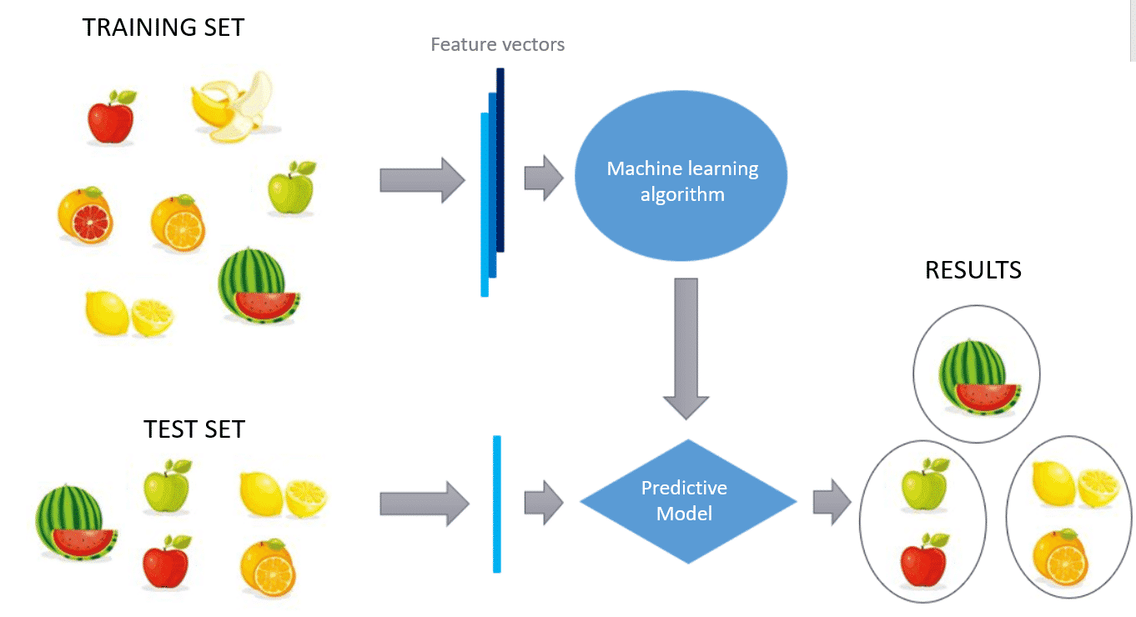
Apache Spark's Mllib – unsupervised learning
Unsupervised Learning deals with unlabeled data, where the goal is to uncover hidden patterns, structures, or relationships within the data.

Slide 20
Apache Spark's Mllib – unsupervised learning
Clustering Algorithms group the data into clusters based on similarity, without any predefined labels.
K-means: org.apache.spark.ml.clustering.KMeans
Bisecting K-means: org.apache.spark.ml.clustering.BisectingKMeans
Gaussian Mixture Models (GMM): org.apache.spark.ml.clustering.GaussianMixture
Latent Dirichlet Allocation (LDA): org.apache.spark.ml.clustering.LDA
Use Cases:
Customer segmentation
Document clustering (e.g., topic modeling)
Anomaly detection

Slide 21
Apache Spark's Mllib – unsupervised learning
Dimensionality Reduction Algorithms reduce the number of features in the dataset while preserving its essential structure.
Principal Component Analysis (PCA): org.apache.spark.ml.feature.PCA
Singular Value Decomposition (SVD): (implemented as part of matrix factorization in Spark MLlib)
Truncated Singular Value Decomposition (SVD): org.apache.spark.ml.feature.TruncatedSVD
Use Cases:
Data compression
Noise reduction
Visualization of high-dimensional data

Slide 22
Apache Spark's Mllib – recommendation systems
Recommendation systems provide personalized recommendations by learning user preferences from historical data. Spark MLlib supports collaborative filtering for building recommendation engines.
Alternating Least Squares (ALS): org.apache.spark.ml.recommendation.ALS
Use Cases:
Movie recommendations (e.g., Netflix)
Product recommendations (e.g., Amazon)
Music recommendations (e.g., Spotify)

Slide 23
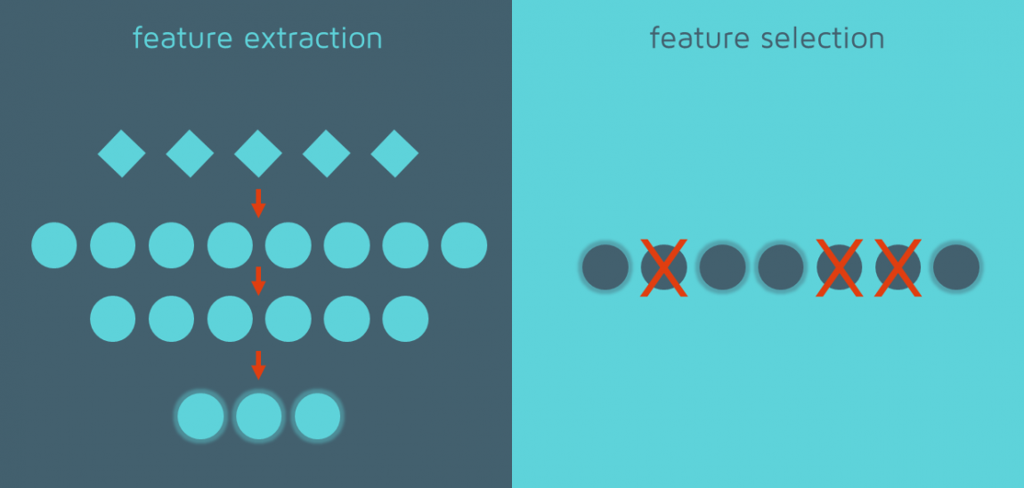
Apache Spark's Mllib – Feature Extraction and Transformation
Though not strictly "learning algorithms" feature extraction and transformation methods are essential for preparing data for machine learning models. Spark MLlib supports various techniques for transforming raw data into features that can be used in models.

Slide 24
Apache Spark's Mllib – Feature Extraction and Transformation
Feature Scaling and Normalization
StandardScaler: org.apache.spark.ml.feature.StandardScaler
MinMaxScaler: org.apache.spark.ml.feature.MinMaxScaler
MaxAbsScaler: org.apache.spark.ml.feature.MaxAbsScaler
Normalizer: org.apache.spark.ml.feature.Normalizer

Slide 25
Apache Spark's Mllib – Feature Extraction and Transformation
Categorical Feature Encoding
One-Hot Encoding: org.apache.spark.ml.feature.OneHotEncoder
StringIndexer: org.apache.spark.ml.feature.StringIndexer
IndexToString: org.apache.spark.ml.feature.IndexToString

Slide 26
Apache Spark's Mllib – Feature Extraction and Transformation
Text Feature Extraction
TF-IDF (Term Frequency-Inverse Document Frequency): org.apache.spark.ml.feature.IDF
Word2Vec: org.apache.spark.ml.feature.Word2Vec
CountVectorizer: org.apache.spark.ml.feature.CountVectorizer
HashingTF: org.apache.spark.ml.feature.HashingTF

Slide 27
Apache Spark's Mllib – Feature Extraction and Transformation
Dimensionality Reduction
PCA (Principal Component Analysis): org.apache.spark.ml.feature.PCA
SVD (Singular Value Decomposition): org.apache.spark.ml.feature.TruncatedSVD

Slide 28
Apache Spark's Mllib – Feature Extraction and Transformation
Use Cases:
Text mining and sentiment analysis
Preparing categorical and numerical data for machine learning models
Reducing the dimensionality of data for visualization

Slide 29
Apache Spark's Mllib – Ensemble Methods
Ensemble methods combine multiple models to improve performance. Spark MLlib supports several ensemble methods, particularly for supervised learning.
Random Forest (Classification and Regression): org.apache.spark.ml.classification.RandomForestClassifier and org.apache.spark.ml.regression.RandomForestRegressor
Gradient-Boosted Trees (Classification and Regression): org.apache.spark.ml.classification.GBTClassifier and org.apache.spark.ml.regression.GBTRegressor
Use Cases:
Predictive modeling in structured data
Improving the accuracy and robustness of models
Handling noisy datasets

Slide 30
Apache Spark's Mllib – Model Evaluation and Tuning
Model Selection and Hyperparameter Tuning
Spark MLlib provides tools for hyperparameter tuning and model selection using cross-validation and grid search.
CrossValidator: org.apache.spark.ml.tuning.CrossValidator
TrainValidationSplit: org.apache.spark.ml.tuning.TrainValidationSplit

Slide 31
Apache Spark's Mllib – Model Evaluation and Tuning
Model Evaluation Metrics
Binary Classification: org.apache.spark.ml.evaluation.BinaryClassificationEvaluator
Multiclass Classification: org.apache.spark.ml.evaluation.MulticlassClassificationEvaluator
Regression: org.apache.spark.ml.evaluation.RegressionEvaluator
Clustering: org.apache.spark.ml.evaluation.ClusteringEvaluator

Slide 32
Apache Spark's Mllib – summary
Category | Algorithms in Spark MLlib
Supervised Learning | Logistic Regression, Decision Trees, Random Forests, GBT, Linear Regression, Naive Bayes, etc.
Classification | Logistic Regression, Decision Trees, Random Forests, GBT, SVM, Naive Bayes, MLP
Regression | Linear Regression, Decision Trees, Random Forests, GBT, Generalized Linear Models, AFT
Unsupervised Learning | K-means, GMM, Bisecting K-means, LDA, PCA, SVD
Clustering | K-means, GMM, Bisecting K-means, LDA
Dimensionality Reduction | PCA, SVD
Recommendation Systems | ALS (Alternating Least Squares)
Ensemble Methods | Random Forests, Gradient-Boosted Trees
Feature Transformation | StandardScaler, MinMaxScaler, StringIndexer, OneHotEncoder, TF-IDF, Word2Vec, etc.
Evaluation & Tuning | CrossValidator, TrainValidationSplit, BinaryClassificationEvaluator, RegressionEvaluator, etc.

Slide 33
Apache Spark's Mllib – summary
Category | Algorithms in Spark MLlib
Supervised Learning | Logistic Regression, Decision Trees, Random Forests, GBT, Linear Regression, Naive Bayes, etc.
Classification | Logistic Regression, Decision Trees, Random Forests, GBT, SVM, Naive Bayes, MLP
Regression | Linear Regression, Decision Trees, Random Forests, GBT, Generalized Linear Models, AFT
Unsupervised Learning | K-means, GMM, Bisecting K-means, LDA, PCA, SVD
Clustering | K-means, GMM, Bisecting K-means, LDA
Dimensionality Reduction | PCA, SVD
Recommendation Systems | ALS (Alternating Least Squares)
Ensemble Methods | Random Forests, Gradient-Boosted Trees
Feature Transformation | StandardScaler, MinMaxScaler, StringIndexer, OneHotEncoder, TF-IDF, Word2Vec, etc.
Evaluation & Tuning | CrossValidator, TrainValidationSplit, BinaryClassificationEvaluator, RegressionEvaluator, etc.

Slide 34
Apache Spark's Mllib – tips
Tips for Working with Spark MLlib
Use DataFrames: Always prefer the DataFrame-based API over the deprecated RDD-based API.
Caching: Cache your data (using .cache()) if you are performing multiple operations or iterations on the same dataset to improve performance.
Parameter Tuning: Use CrossValidator or TrainValidationSplit for hyperparameter tuning.
Model Persistence: Save and load models with the save() and load() methods to reuse them across different sessions.
Scaling Data: Many algorithms perform better when features are scaled. Always consider using StandardScaler or MinMaxScaler.

